Slide 1

NGO-ISAC
Security Awareness Training
https://www.ngoisac.org/ membership@ngoisac.org
Summer, 2025

Slide 2
Closely Related Mission/Topics
ID of Critical Functions- The purpose of this mission is to support the Beneficiary in identifying critical functions essential for service delivery within their NGO. The Builders assist by evaluating the organization's operations, systems, and processes to determine the key functions that require special attention from a cybersecurity perspective. This helps prioritize resources and focus on protecting the most crucial aspects of the NGO's services
MFA Advice- In this mission, the Beneficiary NGO receives guidance on Two-Factor Authentication (2FA) and explores the implementation of 2FA across the websites and platforms used in their daily activities. The Builders explain the benefits of 2FA, provide recommendations on suitable authentication methods, and help in the deployment of 2FA to strengthen account security and protect against unauthorized access.

Slide 3
Definitions
Incident A cybersecurity event that prompts:
Response - "Weird, what's that?"
Recovery - "Let's plug that hole before…"
Breach
Loss of Control
Compromise
Disclosure
Persistent Access
it's an incident until a lawyer says

Slide 4

Risk Primer
Estimation Models
Black Swan Events
Never happens
Inconceivable
Inevitable
Blind spots
Notes:
Tail risk and model estimation

Slide 5
Overview
Pre Attack
Situational Awareness
Asset Management
Password Management
Multi Factor Authentication
Updates
Incident Planning
Post Attack
Use The Plan
Communicate

Slide 6
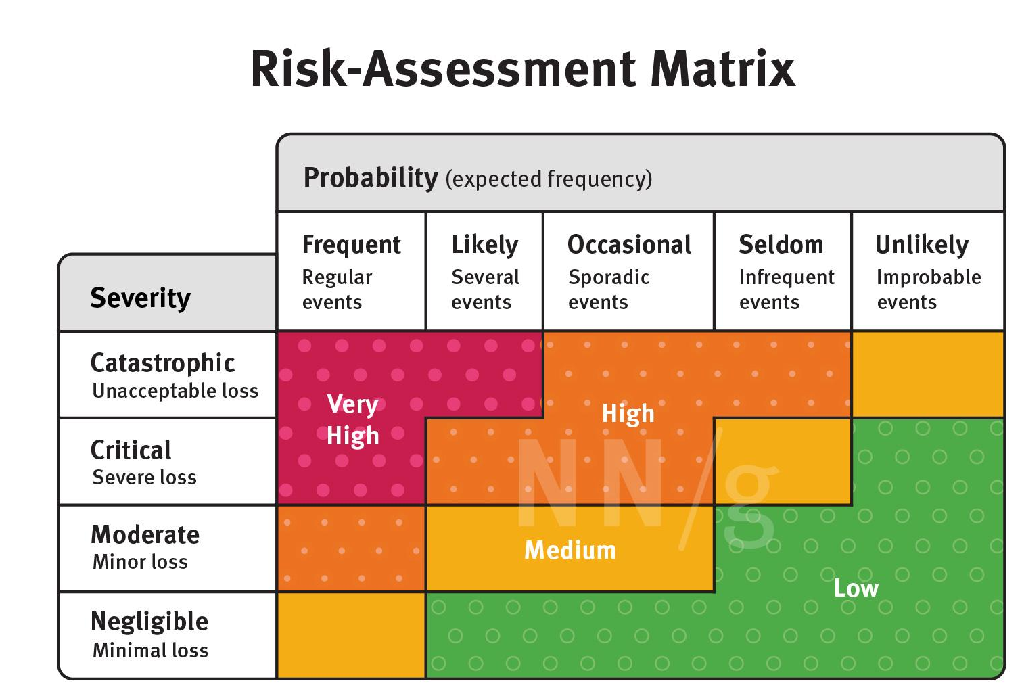
https://www.nngroup.com/articles/design-risk-management/
Notes:
We should take care of what

Slide 7
volcano
https://www.nngroup.com/articles/design-risk-management/
Notes:
We should take care of what

Slide 8
dollhouse
furniture
theft
https://www.nngroup.com/articles/design-risk-management/
Notes:
We should take care of what

Slide 9
phishing
https://www.nngroup.com/articles/design-risk-management/
Notes:
We should take care of what

Slide 10
medical
database
theft
https://www.nngroup.com/articles/design-risk-management/
Notes:
We should take care of what

Slide 11
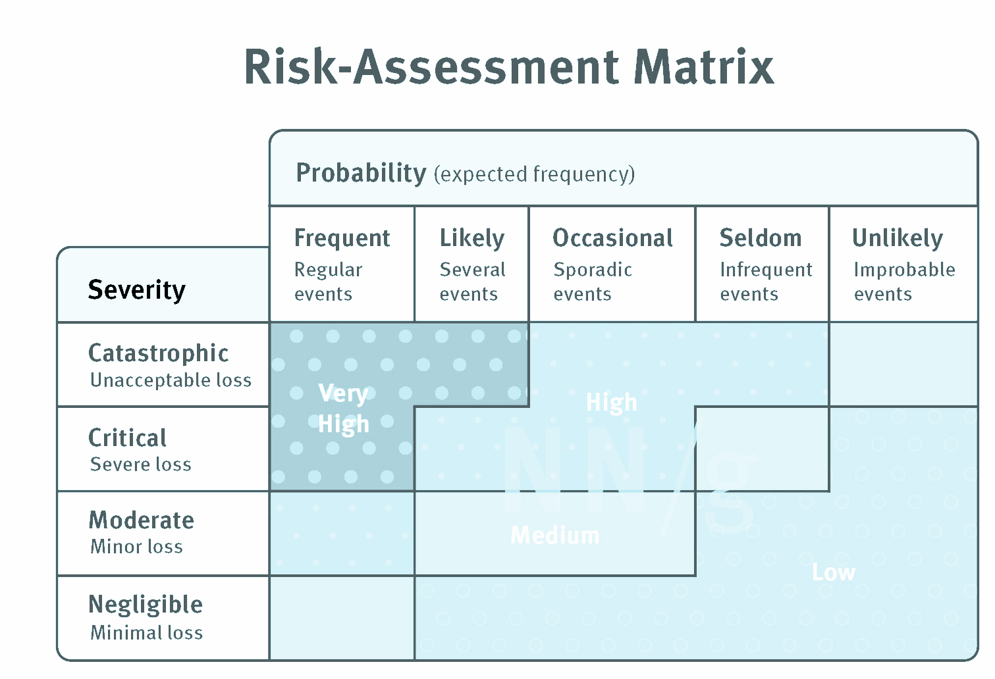

med
database
theft
medical
database
theft
Data Loss Prevention
https://www.nngroup.com/articles/design-risk-management/
Notes:
We should take care of what

Slide 12

What problem?
Categories of Threat Actors
Kids
Low money
Peer recognition (LuLz)
Activists
Some money
Personal political
Insiders
Personal grievance
Organized Crime
All about money
Nation State
National political
Nearly infinite resources

Slide 13
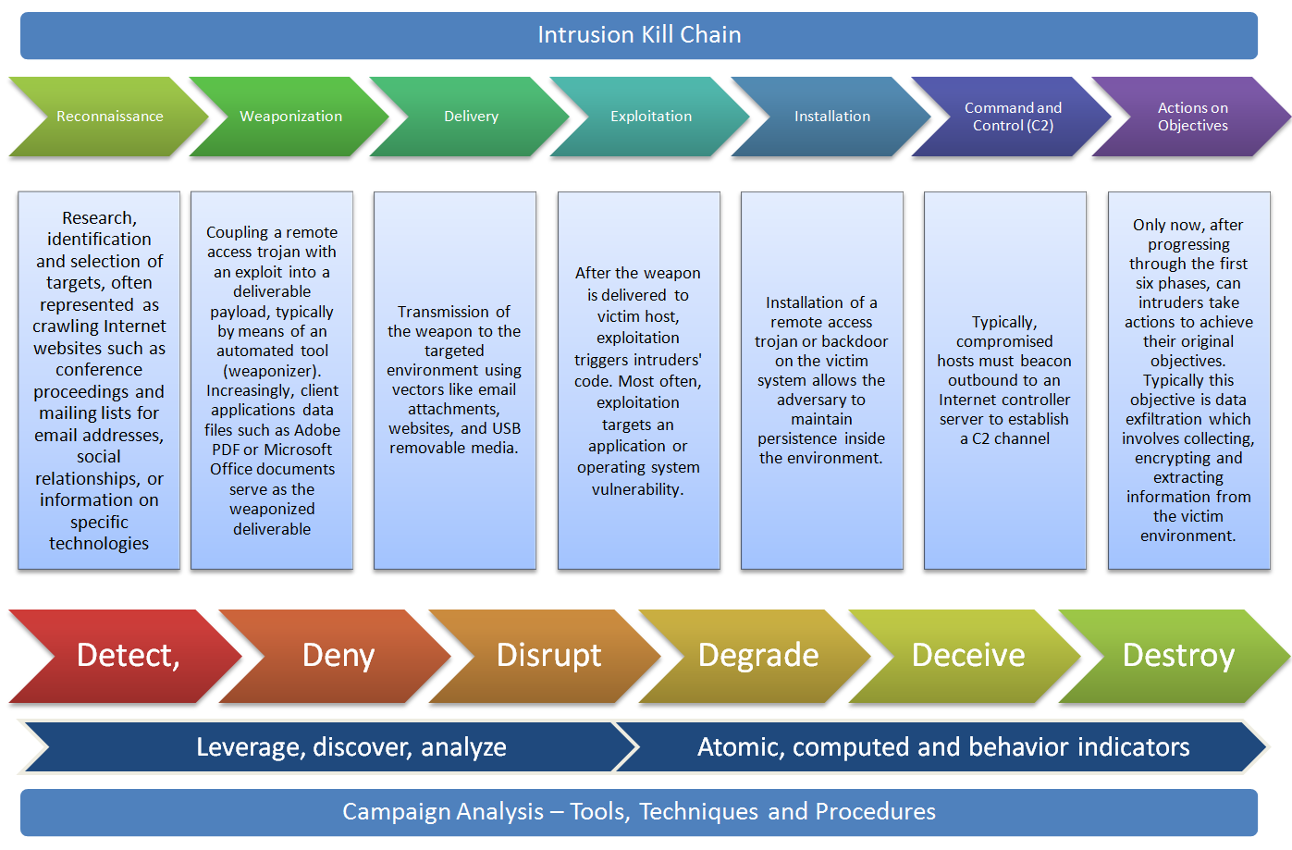
Notes:
DoD Cyber security kill chain, the upper arrows are things that attackers do to gain access to your system, the bottom arrows are about what defenders can do to stop attackers. The middle section exposition describes the attacker path.
These are the risks we are looking for and trying to prevent

Slide 14


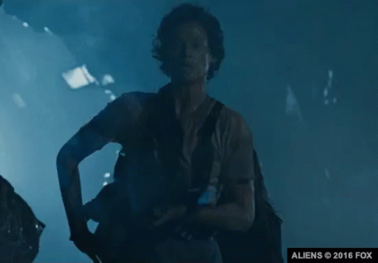

Security Modes
Mitigate
“Avoid the problem.”
Monitor
“Be aware of the problem”
React
“Deal with the problem”
Learn
“Communicate and share”
Meme
Meme
Meme
Meme

Slide 15
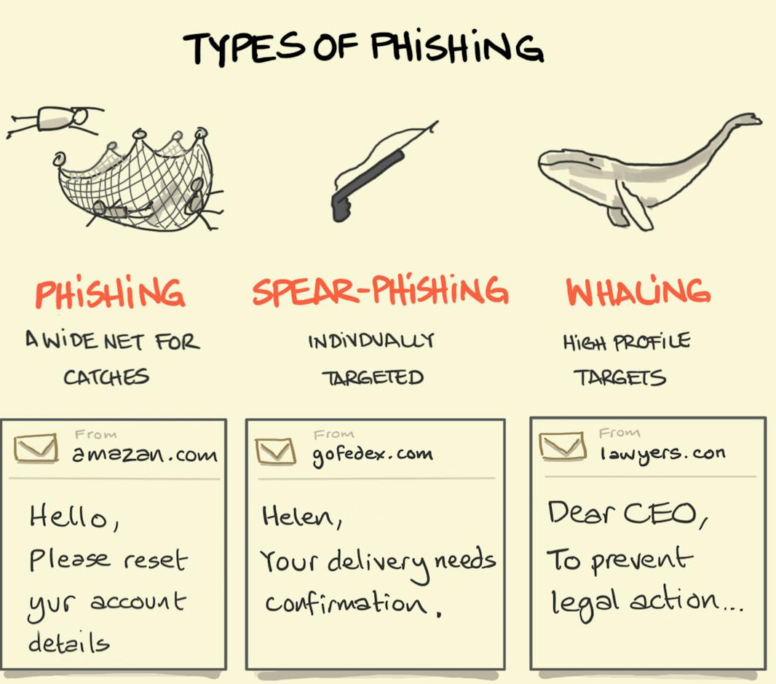
Phishing
Notes:
Phishing is a general term to mean an attacker asking the victim to hand over assets to them.
It’s digital con-artistry
Used to be email, but now as our digital lives have expended to more platforms it’s anything.
Email
Social Media (facebook, tiktok, snapchat)
Dating sites (tinder, bumble, hinge, grindr)
Messaging Platforms (apple messenger, telegram, sms)
Video Games

Slide 16
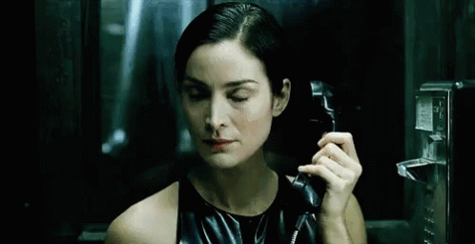
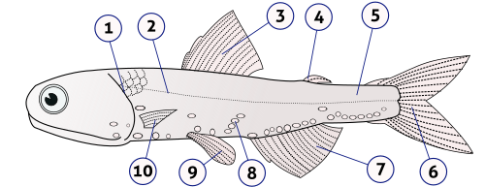
Anatomy of a Phish
The image translators work for the construct attacker
Notes:
Phishing is a general term to mean an attacker asking the victim to hand over assets to them.
It’s digital con-artistry
Used to be email, but now as our digital lives have expended to more platforms it’s anything.
Email
Social Media (facebook, tiktok, snapchat)
Dating sites (tinder, bumble, hinge, grindr)
Messaging Platforms (apple messenger, telegram, sms)
Video Games

Slide 17
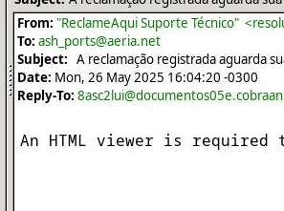
anatomy of a phish
Your attention is the product
Did You Look?
Email Should Not Be Interactive
Preview Images
Read Receipts
Motion
Buttons
Language
Notes:
Phishing is a general term to mean an attacker asking the victim to hand over assets to them.
It’s digital con-artistry
Used to be email, but now as our digital lives have expended to more platforms it’s anything.
Email
Social Media (facebook, tiktok, snapchat)
Dating sites (tinder, bumble, hinge, grindr)
Messaging Platforms (apple messenger, telegram, sms)
Video Games

Slide 18
anatomy of a phish URL
https://www.rfc-editor.org/rfc/rfc3986#page-45?semantic-attack
Mapping all of human knowledge into a label:
standard
60 pages
Notes:
Phishing is a general term to mean an attacker asking the victim to hand over assets to them.
It’s digital con-artistry
Used to be email, but now as our digital lives have expended to more platforms it’s anything.
Email
Social Media (facebook, tiktok, snapchat)
Dating sites (tinder, bumble, hinge, grindr)
Messaging Platforms (apple messenger, telegram, sms)
Video Games

Slide 19
anatomy of a phish URL
protocol
domain
path
weird hair
https://www.rfc-editor.org/rfc/rfc3986#page-45?semantic-attack
Notes:
Phishing is a general term to mean an attacker asking the victim to hand over assets to them.
It’s digital con-artistry
Used to be email, but now as our digital lives have expended to more platforms it’s anything.
Email
Social Media (facebook, tiktok, snapchat)
Dating sites (tinder, bumble, hinge, grindr)
Messaging Platforms (apple messenger, telegram, sms)
Video Games

Slide 20
anatomy of a phish URL
top level domain
weird hair
domain
https://www.rfc-editor.org/rfc/rfc3986#page-45?semantic-attack
nice top level domain:
.org
.edu
.gov
interesting:
.biz
.xx
.tv
Notes:
Phishing is a general term to mean an attacker asking the victim to hand over assets to them.
It’s digital con-artistry
Used to be email, but now as our digital lives have expended to more platforms it’s anything.
Email
Social Media (facebook, tiktok, snapchat)
Dating sites (tinder, bumble, hinge, grindr)
Messaging Platforms (apple messenger, telegram, sms)
Video Games

Slide 21
anatomy of a phish URL
path
https://www.rfc-editor.org/rfc/rfc3986#page-45?semantic-attack
Nice:
/pub/cats/momo.jpeg
Interesting:
/amp/s/timeshare.gotcha.com
Notes:
Phishing is a general term to mean an attacker asking the victim to hand over assets to them.
It’s digital con-artistry
Used to be email, but now as our digital lives have expended to more platforms it’s anything.
Email
Social Media (facebook, tiktok, snapchat)
Dating sites (tinder, bumble, hinge, grindr)
Messaging Platforms (apple messenger, telegram, sms)
Video Games

Slide 22
Anatomy of a phish URL
weird hair
https://www.rfc-editor.org/rfc/rfc3986#page-45?semantic-attack
Magick:
Queries
Tracking Tokens
Hidden Messages
Watermarks
Authentication
Try without the hair
Notes:
Phishing is a general term to mean an attacker asking the victim to hand over assets to them.
It’s digital con-artistry
Used to be email, but now as our digital lives have expended to more platforms it’s anything.
Email
Social Media (facebook, tiktok, snapchat)
Dating sites (tinder, bumble, hinge, grindr)
Messaging Platforms (apple messenger, telegram, sms)
Video Games

Slide 23
Anatomy of a Phish
View source with f12/ctrl+u:
lower case domain names
‘i’ vs ‘I’ vs ‘l’ vs ‘L’
sender plausible?
homoglyph attack
Notes:
Phishing is a general term to mean an attacker asking the victim to hand over assets to them.
It’s digital con-artistry
Used to be email, but now as our digital lives have expended to more platforms it’s anything.
Email
Social Media (facebook, tiktok, snapchat)
Dating sites (tinder, bumble, hinge, grindr)
Messaging Platforms (apple messenger, telegram, sms)
Video Games

Slide 24
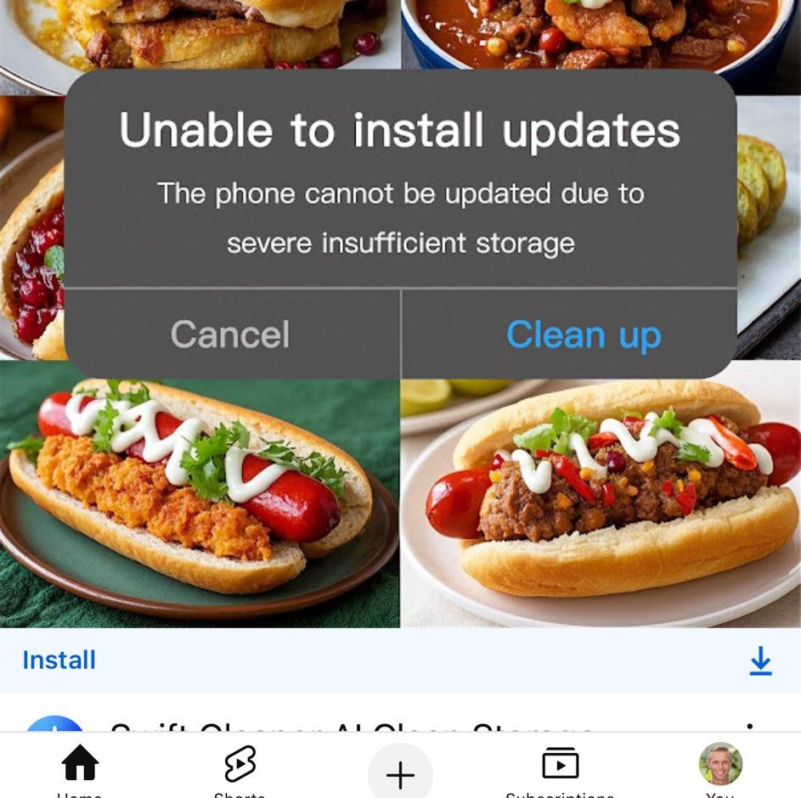
Anatomy of a Phish
You are the Product
Astonish
Interact
Infect
Youtube app prompts attack:
Notes:
Phishing is a general term to mean an attacker asking the victim to hand over assets to them.
It’s digital con-artistry
Used to be email, but now as our digital lives have expended to more platforms it’s anything.
Email
Social Media (facebook, tiktok, snapchat)
Dating sites (tinder, bumble, hinge, grindr)
Messaging Platforms (apple messenger, telegram, sms)
Video Games

Slide 25
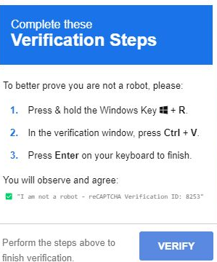
anatomy of a phish
Captcha prompts attack
Run this cool script
Notes:
Phishing is a general term to mean an attacker asking the victim to hand over assets to them.
It’s digital con-artistry
Used to be email, but now as our digital lives have expended to more platforms it’s anything.
Email
Social Media (facebook, tiktok, snapchat)
Dating sites (tinder, bumble, hinge, grindr)
Messaging Platforms (apple messenger, telegram, sms)
Video Games

Slide 26
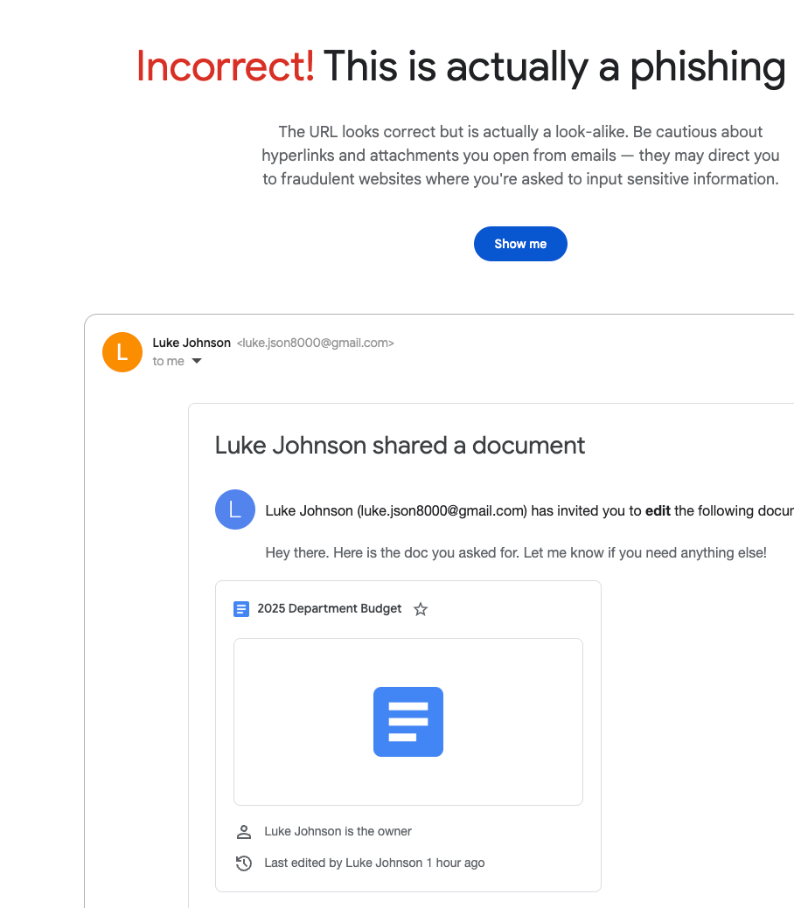
Anatomy of a Phish
Serve yourself:
https://phishingquiz.withgoogle.com/
Notes:
Phishing is a general term to mean an attacker asking the victim to hand over assets to them.
It’s digital con-artistry
Used to be email, but now as our digital lives have expended to more platforms it’s anything.
Email
Social Media (facebook, tiktok, snapchat)
Dating sites (tinder, bumble, hinge, grindr)
Messaging Platforms (apple messenger, telegram, sms)
Video Games

Slide 27

QR Codes are programs Malware
This object is cursed
Activates whatever is at the destination
Tampering/spoofing
Menu skimming
Inspect app, link, etc

Slide 28

Take 9 Seconds For A Safer World
Take a 9 second pause and think before you click, download, or share.
Learn more at bit.ly/NGO_ISAC-Take9
#Take9 #CybersecurityAwareness

Slide 29
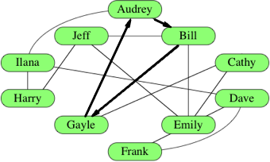
Business Email Compromise (BEC)
Criminals gain access to a legitimate email account,
through social engineering
successful phish
computer intrusion
Emails come from trusted source
Request money or sensitive information
Most common and expensive type of internet fraud

Slide 30
Working Group Protection
Distro lists are “working groups”
General Advice
Limit lateral compromise
Scrub cc: lists
Use formal file sharing
No file attachments
Train users to be suspicious
Unexpected Requests for $
Links
Schedule changes
New users in chat
Misspellings
https://www.khanacademy.org/computing/computer-science/algorithms/graph-representation/a/describing-graphs

Slide 31

Extortion: I’ve seen your XXX. Pay me!
Excellent taste
Your neighbors nervous
Discrecion guaranteed

Slide 32
Extortion: I’ve seen your XXX. Pay me!
Unlikely
Mad Libs software
Examinine details like phishing ( typography, spelling)
Federal when: Hobbs Act
Harm Economic, Physical
Obstruct Interstate commerce
FBI i3c crime report

Slide 33
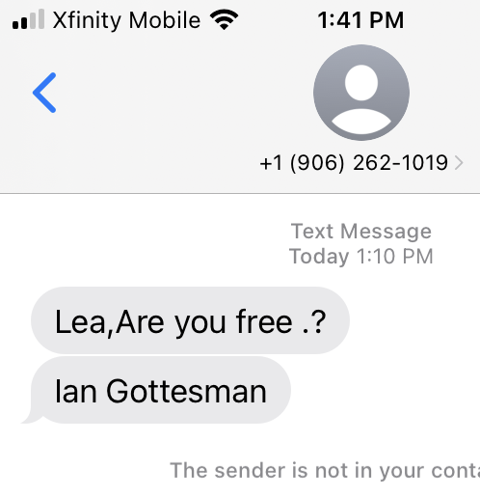
What’s “pretexting”?
Business Email Compromise
Can be as simple as an attacker submitting a bill
Steal corp executive credentials
Reputation attack

Slide 34
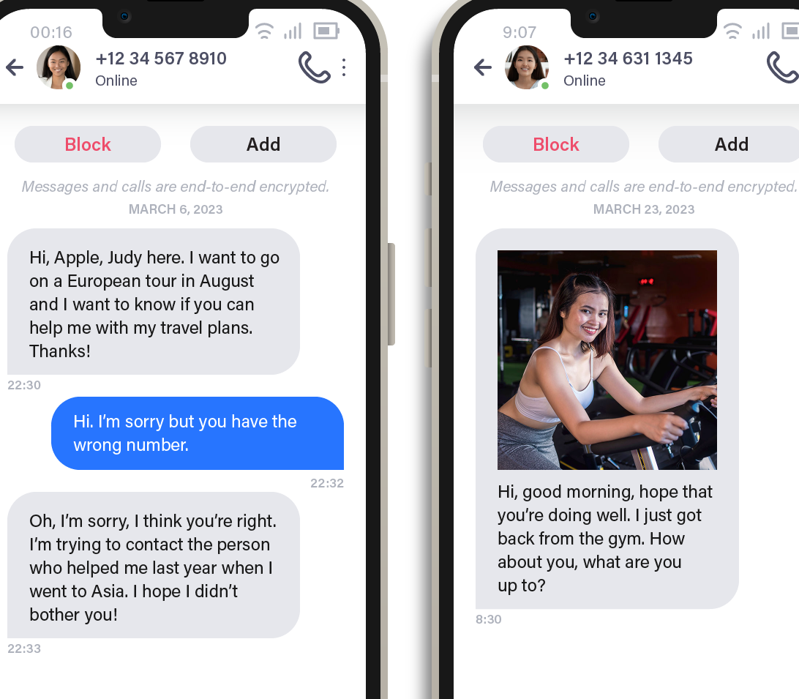
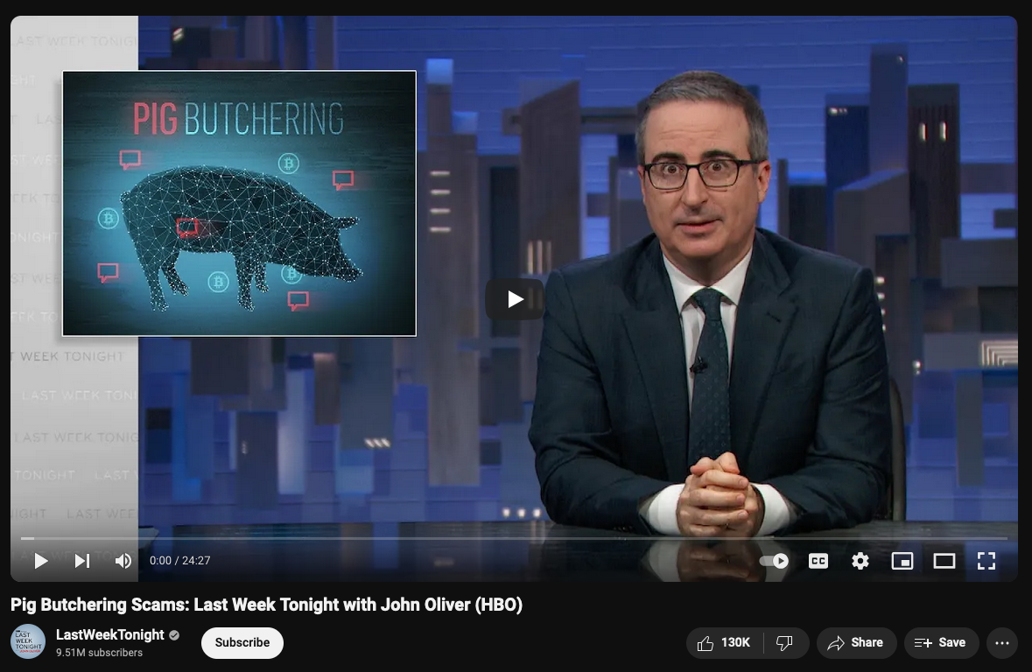
Pig Butchering
Mass Fraud
ProPublica Article
John Oliver discussed in episode Feb 2024
Crypto-currency
Notes:
These are horrible and have been linked to human slavery and terrible terrible ends.
Tend to start as text message about “hey do you remember me” and quickly goes into fake crypto market place, where they encourage you to put money

Slide 35
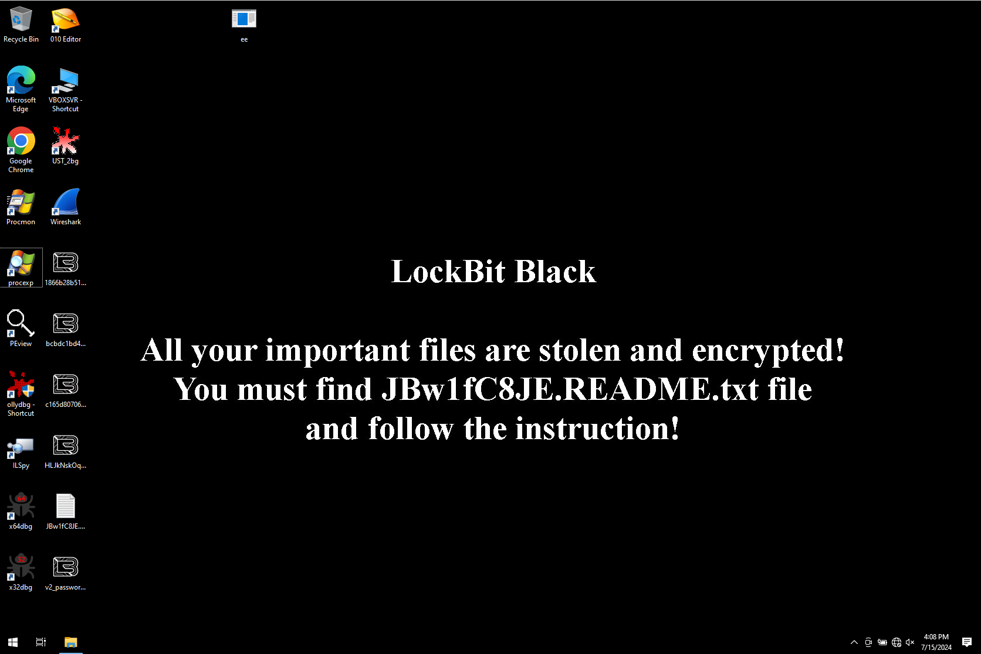
What is “ransomware”?
Notes:
Ransomware is a type of malicious attack where attackers encrypt an organization’s data and demand payment to restore access.
Here’s an example of how a ransomware attack can occur:
A user is tricked into clicking on a malicious link that downloads a file from an external website.
The user executes the file, not knowing that the file is ransomware.
The ransomware takes advantage of vulnerabilities in the user’s computer and other computers to propagate throughout the organization.
The ransomware simultaneously encrypts files on all the computers, then displays messages on their screens demanding payment in exchange for decrypting the files.
https://www.nist.gov/itl/smallbusinesscyber/guidance-topic/ransomware

Slide 36
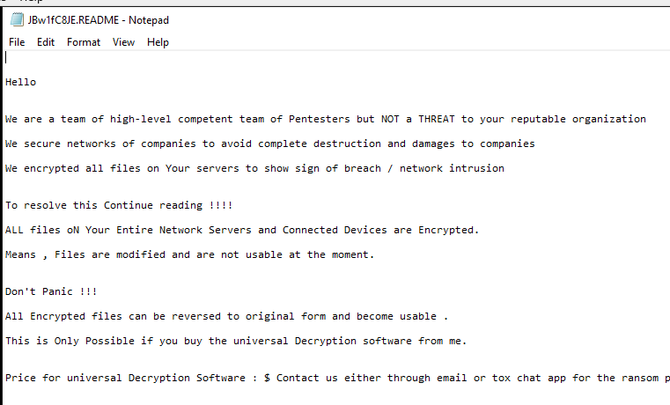

Slide 38
Paying Ransom
United Health Paid
Twice
And never got their files
Paying doesn’t work.
Ransomware is SaaS
B-teams do the data recovery
Sometimes
Negotiators
Victim trust prerequisite
Notes:
Ransomware is a type of malicious attack where attackers encrypt an organization’s data and demand payment to restore access.
Here’s an example of how a ransomware attack can occur:
A user is tricked into clicking on a malicious link that downloads a file from an external website.
The user executes the file, not knowing that the file is ransomware.
The ransomware takes advantage of vulnerabilities in the user’s computer and other computers to propagate throughout the organization.
The ransomware simultaneously encrypts files on all the computers, then displays messages on their screens demanding payment in exchange for decrypting the files.
https://www.nist.gov/itl/smallbusinesscyber/guidance-topic/ransomware

Slide 39
Preventing Ransomware
Data Protection Plan
Destruction too
Structured Storage Plan
Crm
Databases
Revision Control
Unstructured Backups
Offline
Snapshots
Notes:
Ransomware is a type of malicious attack where attackers encrypt an organization’s data and demand payment to restore access.
Here’s an example of how a ransomware attack can occur:
A user is tricked into clicking on a malicious link that downloads a file from an external website.
The user executes the file, not knowing that the file is ransomware.
The ransomware takes advantage of vulnerabilities in the user’s computer and other computers to propagate throughout the organization.
The ransomware simultaneously encrypts files on all the computers, then displays messages on their screens demanding payment in exchange for decrypting the files.
https://www.nist.gov/itl/smallbusinesscyber/guidance-topic/ransomware

Slide 40
Protect Yourself
Awareness
Password Manager
Rotate Your Passwords (Fire Drill)
MFA Everywhere
Evaluate Partners' Controls
Run Updates
VPNs**

Slide 41
MFA Multi-Factor Authentication is the way:
SMS/Email/Voice One-Time Passwords
App authentication Time based One-Time Passwords (TOTP)
Universal 2nd Factor (U2F) via hardware devices
Yubikey provides free keys to many ngos
Passkeys – device authentication provider (passwordless)
Notes:
Many password can also help you manage your MFA tokens.

Slide 42
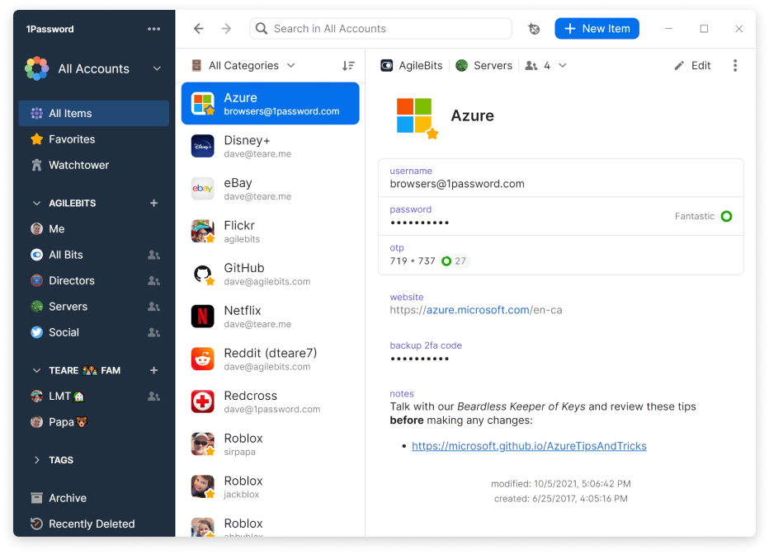
Password Managers
List of password managers
1password
Keeper
LastPass
bitwarden.com
Dashlane
NordPass (free to NGOs)
Apple Passwords
Google Password
Microsoft Authenticator
Notes:
We have on average 100+ online accounts https://www.cnn.com/2024/02/26/tech/digital-legacy-planning-personal-technology/index.html
Until we all move to systems that are passwordless, you should use a password manager.
That password manager you use should be
Easy to use
always available to you (including when you’re offline)
Strongly encrypted
Extra bonus to using a collaborative password manager to share passwords. Don’t just copy and paste passwords in your messaging platform like Slack

Slide 43
Authentication tree
Hardware key
Password Manager
TOTP enabled
service

Slide 44
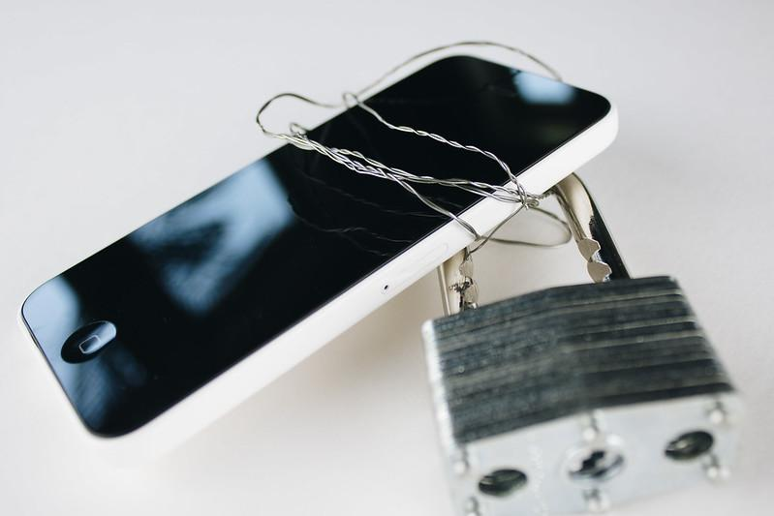
Advanced Account Protections
Google, Apple, and Microsoft have advanced protection
Google Advanced Protection Program
Once enabled all of your devices tied to that account are protected
Microsoft 365 Advanced Protection
Applies to Outlook and OneDrive
Apple Lockdown Mode
On a per device basis, each device must be separately enrolled
iPhone
Macbooks
iPad
Notes:
The problem with these systems is how obtrusive they are. There are always tradeoffs.
Google APP is probably the most transparent and easiest to use.
Apple Lockdown Mode is particularly onerous bc it prevents the sharing of apple photo albums, and it works on a per device basis

Slide 45
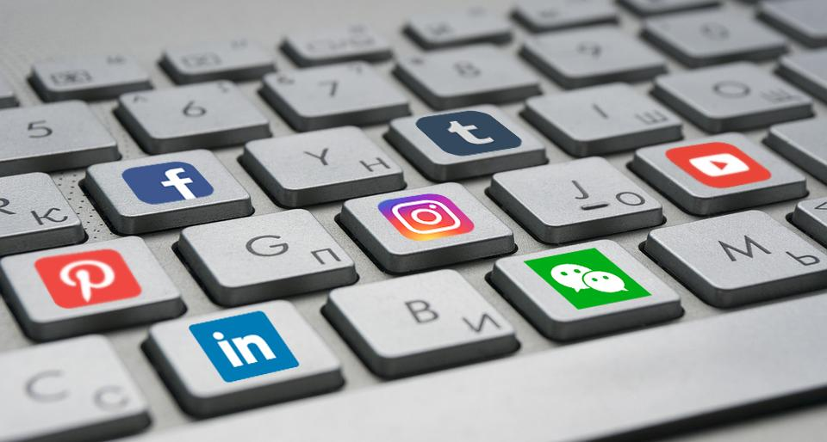
Socials
Attackers use social networks to pivot into organization attacks
Enable MFA for social accounts
Family parity
Be suspicious of shop talk in DM
Gift card request from CEO?
Written comms policy
Prevent lateral expansion

Slide 46
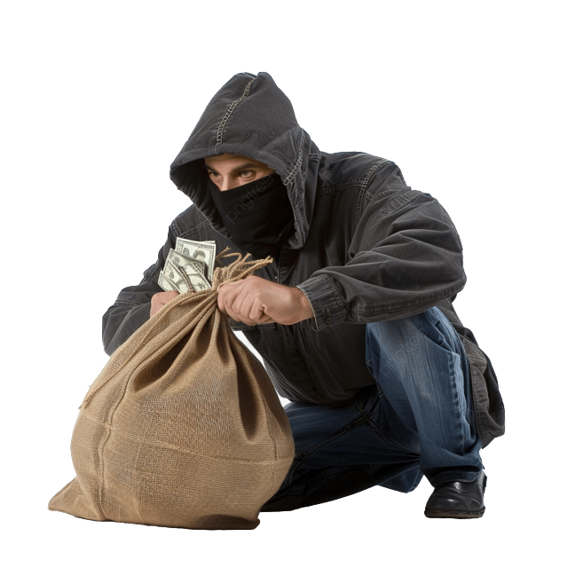
Protecting your financial accounts
Real time monitor your financial transactions
Have a verbal PIN for your finance accounts
Get an IRS PIN
Be aware that venmo transactions can be made public
Zelle has no fraud migitation
Annual Credit Report
Business Credit Reports are a thing
freeze credit as default
Use Credit Cards as firewalls for debit accounts

Slide 47
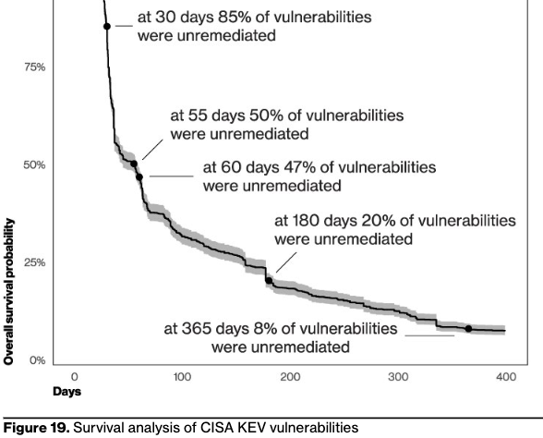
Timely Software and Hardware Updates/ Patches

Slide 48
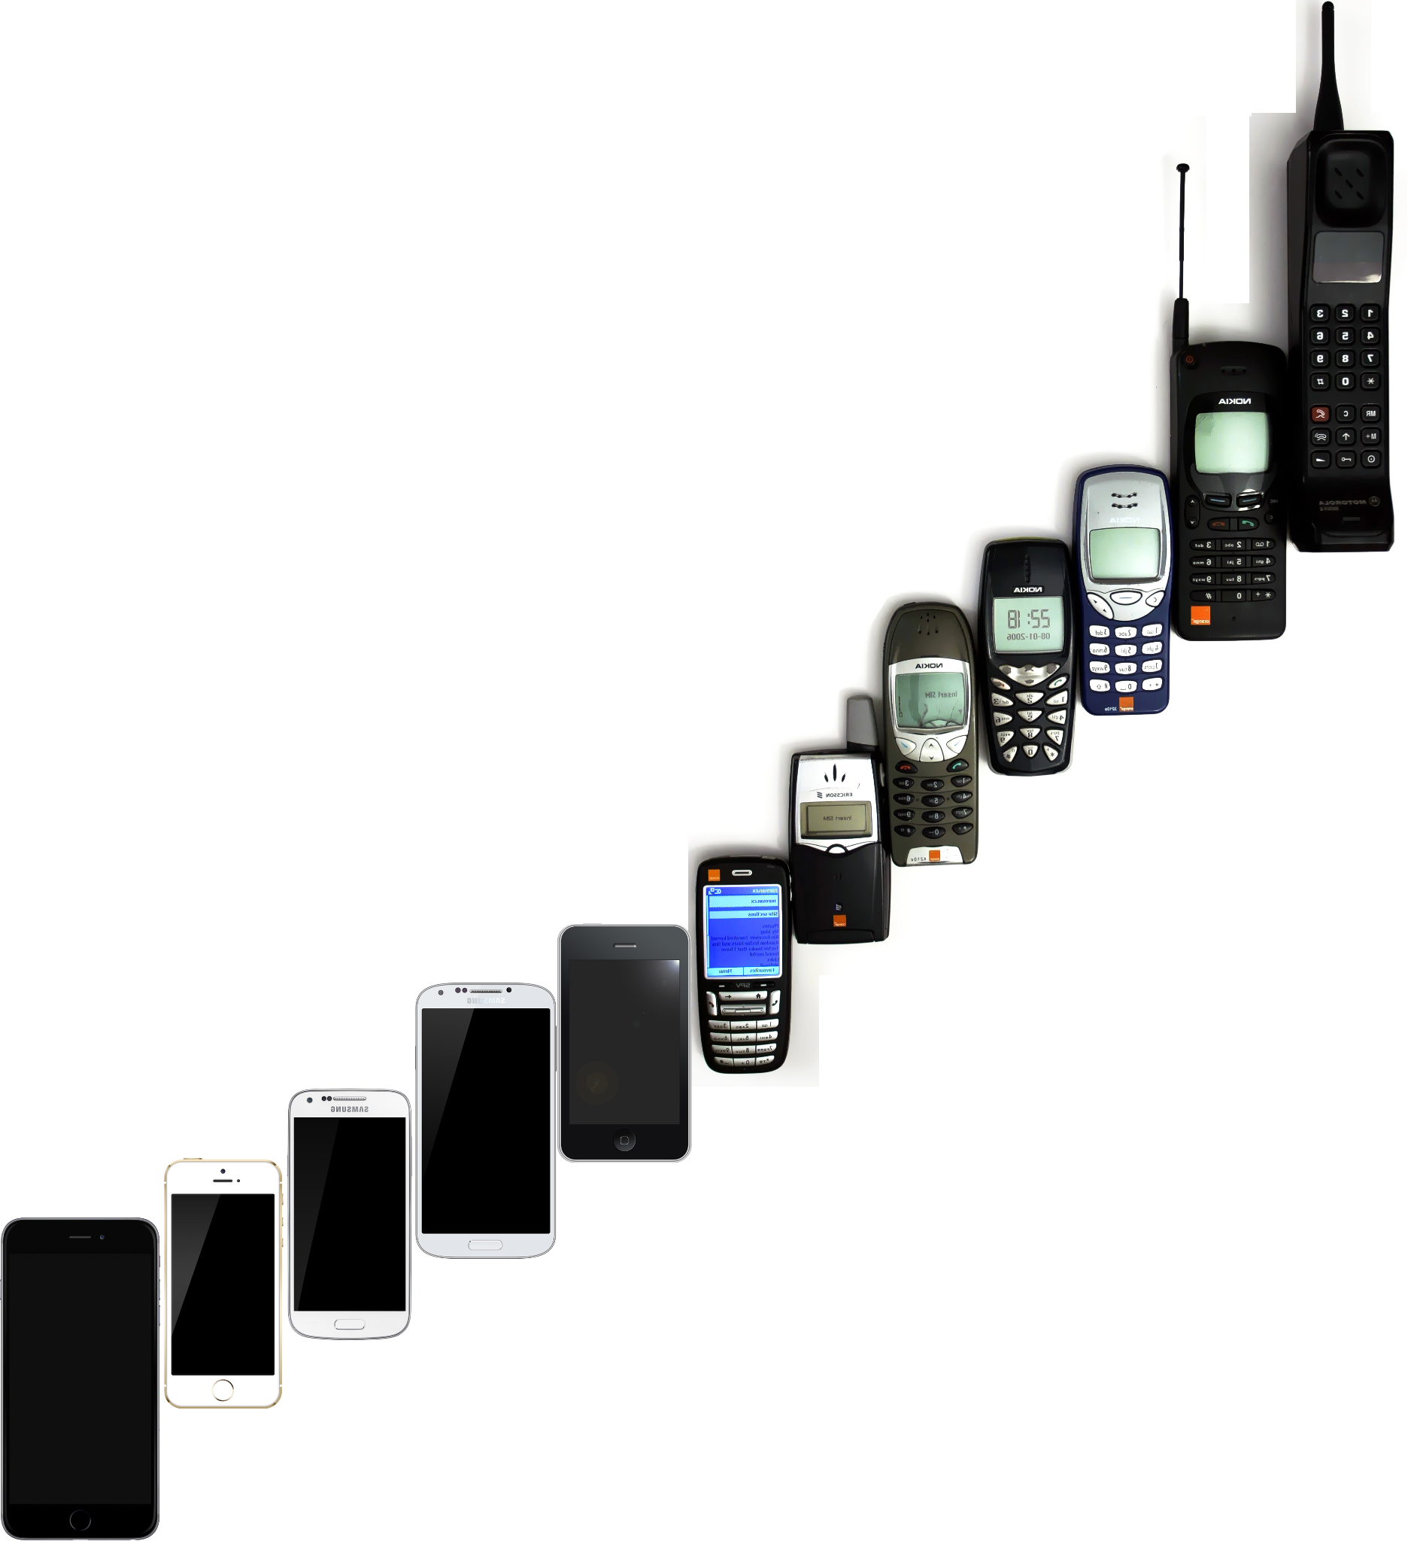
Mobile Devices
A mobile device is your digital twin
Enable APP or Lockdown mode
Phones older than 5 years
What do you do when you lose control of a device?
Enable “Find My”
Remotely wipe
Enable Auto Updates
Secure Messaging Apps
Signal
Remove apps
Keep another device for games

Slide 49
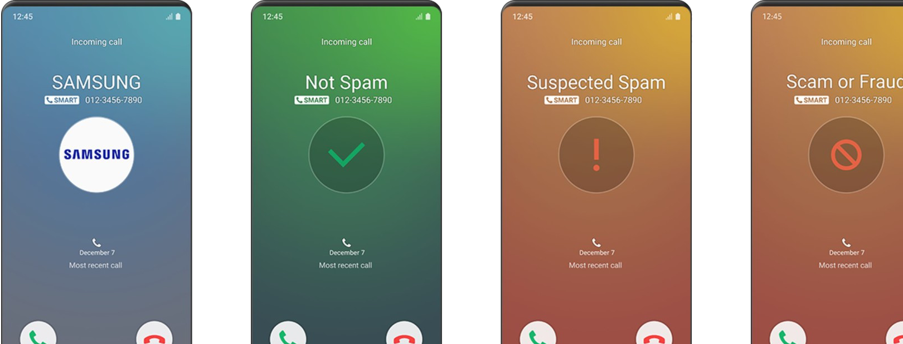
SPAM Calls and Caller ID Authentication
FCC maintains the list of call blocking resources
https://www.fcc.gov/consumers/guides/stop-unwanted-robocalls-and-texts

Slide 50
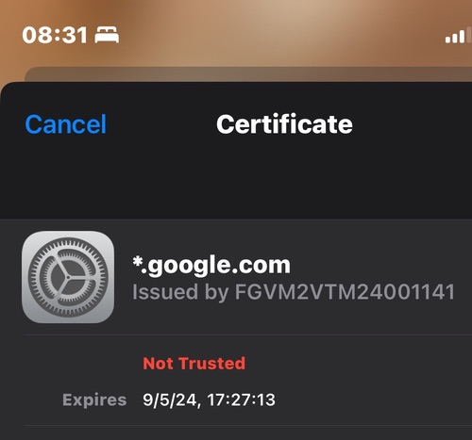
VPNs : why? when?
Virtual private networks
requires engineering prep
does not protect you from the ends
problem is at the destination
protects network transport
Notes:
VPNs protect your traffic from network operators that might be monitoring your network.

Slide 51
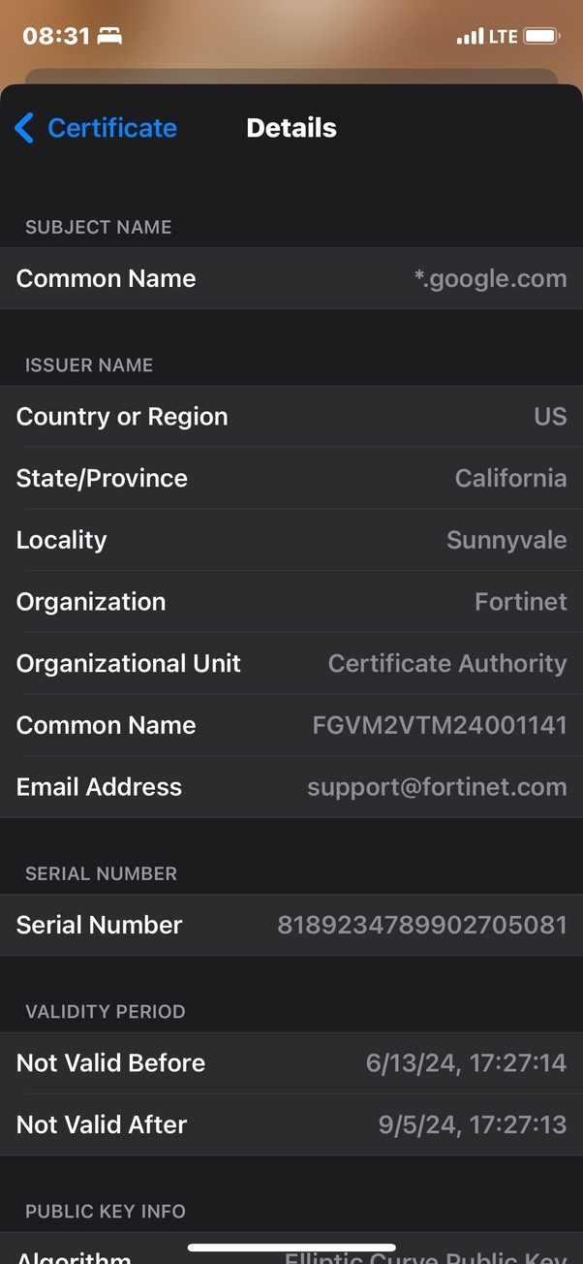
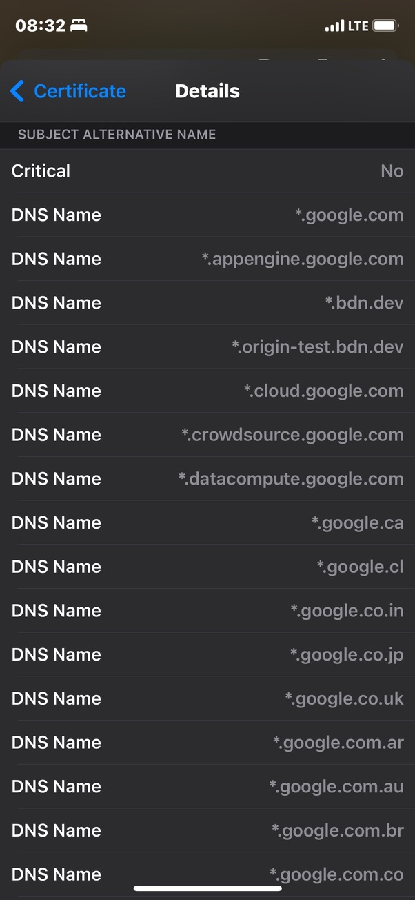
network hijack in progress - receipts

Slide 52
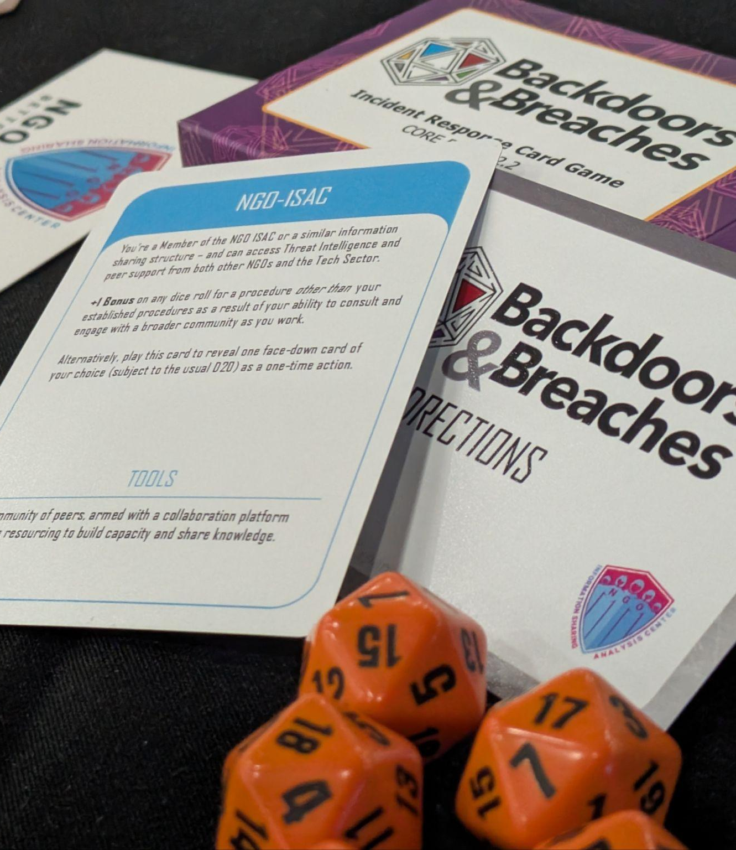
Incident Simulation
As a fun game
Prepare staff
Vocabulary
Appropriate response
Ask about our booster
Fork and play
https://ngoisac.github.io/play.backdoorsandbreaches.com/
Notes:
What is Backdoors & Breaches?
Backdoors & Breaches is a card-based tabletop exercise game designed to help organizations practice and improve their incident response capabilities in a fun, engaging format. Created by security experts Jason Blanchard and Black Hills Information Security, the game simulates real-world cybersecurity incidents, allowing teams to work through breach scenarios in a low-stress environment before facing them in reality.
How the Game Works
Core Components:
Initial Compromise Cards: Represent ways attackers first enter your systems
Pivot & Escalate Cards: Show how attackers move laterally and gain privileges
Persistence Cards: Illustrate methods attackers use to maintain access
C2 (Command & Control) Cards: Demonstrate how attackers control compromised systems
Procedure Cards: Detail defensive security measures and controls
Inject Cards: Introduce unexpected complications during the exercise
Gameplay:
A facilitator (the "Incident Master") sets up a scenario using randomly drawn attack cards
Players form an incident response team and work through the breach scenario
The team must identify the attack path and determine appropriate response actions
Procedure cards test whether the organization has controls in place to detect and respond
Inject cards add realistic challenges and complications
Benefits of Playing
Practical Experience: Provides hands-on practice with incident response procedures
Identifies Gaps: Reveals weaknesses in your security controls and response plans
Builds Teamwork: Improves communication between technical and non-technical staff
Creates Muscle Memory: Develops instinctive response capabilities for real incidents
No Technical Prerequisites: Accessible to participants at all technical levels
Who Should Play
Information Security Teams
IT Support Staff
Executives and Management
Business Continuity Teams
Risk Management Professionals
Anyone involved in incident response
Getting Started
The game can be played in as little as one hour, making it easy to incorporate into meetings or training sessions. The core deck is available for purchase, and there's also a free print-and-play version available online. Organizations can customize scenarios to match their specific infrastructure and threat landscape.
Backdoors & Breaches represents a shift from theoretical security planning to practical, scenario-based preparation. By regularly playing through different attack scenarios, organizations can build resilience and confidence in their ability to detect, respond to, and recover from cybersecurity incidents when—not if—they occur.

Slide 53
Incident Planning
Detection/Containment Procedures
Prepare Staff
Identify Team, Responsibilities
Comms Back Channels
Appropriate Response
Recovery
From Cold Storage
Online
Ask About Our Templates
Notes:
via claude
: Create a Complete Inventory
Document all hardware, software, and data assets
Identify critical systems and their dependencies
Establish baseline normal operations for later comparison
Develop a Formal Incident Response Plan
Define what constitutes an incident
Establish clear roles and responsibilities (who does what)
Create communication protocols (internal and external)
Document step-by-step procedures for common incidents
Include escalation paths and decision-making authority
Build and Train Your Response Team
Designate team members with specific responsibilities
Provide specialized training in incident handling
Conduct regular tabletop exercises and simulations
Ensure 24/7 coverage with on-call rotations if necessary
Implement Detection and Containment Procedures
Deploy monitoring tools and establish alert thresholds
Create containment strategies for different incident types
Develop evidence collection and preservation procedures
Document eradication and recovery processes
Review and Improve Continuously
Schedule regular plan reviews (at least annually)
Conduct post-incident analyses after every event
Update plans based on lessons learned
Test updates through additional simulations
Stay current with evolving threats and best practices
Each of these steps should be documented, regularly tested, and updated as your organization's technology environment changes or new threats emerge.

Slide 54
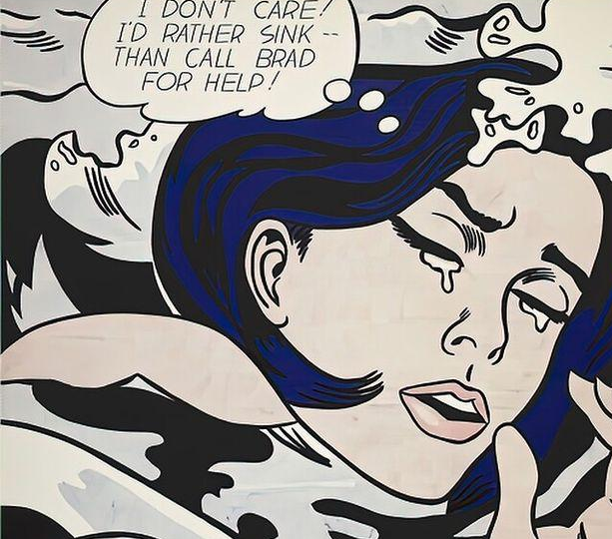
After an Attack
Communicate
Lawyer
Reporting requirements
State
GDPR,HIPAA
CIRCA
Who?
Upstream
Downstream
NGO-ISAC
IR response company
Notes:
https://en.wikipedia.org/wiki/Drowning_Girl

Slide 55
Breach Reporting
Timeline Recording
Record The Time Zones
Iso8601 Times Yyyy-Mm-Dd
Forensics Goals
Chain Of Custody
Collateral Collection
Attribution **

Slide 56
Security Modes
Mitigate
“Avoid the problem.”
Monitor
“Be aware of the problem”
React
“Deal with the problem”
Learn
“Communicate and share”
Meme
Meme
Meme
Meme

Slide 57








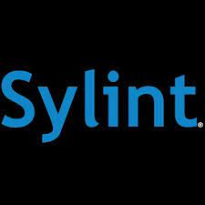





partners

Slide 58
[ Questions ? ]
Notes:
Be ready for: Constellation, Membership dues

